Slide 1
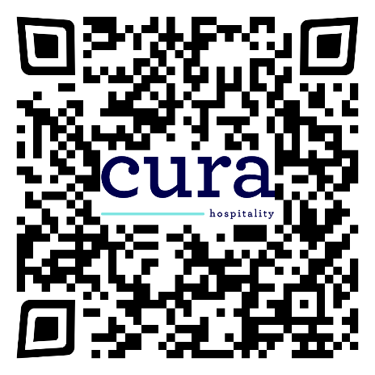
$750 SIGN-ON BONUS!!
With a focus on culinary innovation and exemplary service, we are committed to making a positive difference in people’s lives every day. Our company is committed to the values of professionalism, service to others and giving our team members the opportunity to reach their full potential.
HIRING:
SERVER & FOOD SERVICE WORKER POSITIONS FOR
Harrison Bay Senior Living
1861 Commerce Blvd,
Mound, MN 55364
MANY POSITIONS AVAILABLE!
Team members enjoy:
Weekly Pay & Competitive Wages
–––
Meals and Uniforms Provided
–––
Paid Time Off & Holiday Pay
–––
No Late Nights
–––
Rotating Weekends
–––
Dental & Vision Benefits
–––
401k Retirement Plan
Apply online today at careers.elior-na.com
or by calling toll free 1.844.354.6762
Elior North America is an Equal Opportunity Employer. Qualified applicants will receive consideration for employment without regard to race, color, religion, sex, national origin, sexual orientation, gender identity, disability or protected veteran status.
Notes:
Company Name: to change, go to Layout and select the company
Body: Calibri Light, 12pt, Accent 5
Callout Heading: Calibri, Bold, 16pt, Text 2/Accent 1, Loose
EEOC: Calibri, Bold, 11pt, black

